Slide 1
PROJECT PRESENTATION
CLOUD NATIVE APPS AND THEIR SIGNIFICANCE IN THE MODERN ERA

Slide 2
TOPICS COVERED IN THIS PRESENTATION
What is Cloud Computing and the service models of CC???
Before Cloud Native applications…..
What is exactly a cloud-native application and it’s detailed Architecture??
Components of a cloud-native application and their detailed analysis.
Development cycle of a Cloud-Native application.
Cloud-native API’s in the present technological market.
The applications of Cloud-native applications in the modern
Regime with 2 special cases.
CONCLUSION

Slide 3
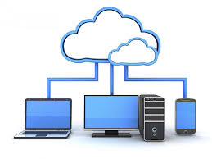
WHAT IS CLOUD COMPUTING???
The practice of using network of remote servers for data storing, management and processing rather than using the local server or a personal memory is called cloud computing.
There are 3 types of cloud-computing service models:
Platform As A Service(PAAS)
Infrastructure As A Service(IAAS)
Software As A Service(SAAS)
Cloud-native approach has become
a major part of cloud-computing domain
with better approach to make highly
Stable, robust applications to the world.

Slide 4
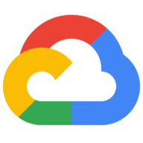
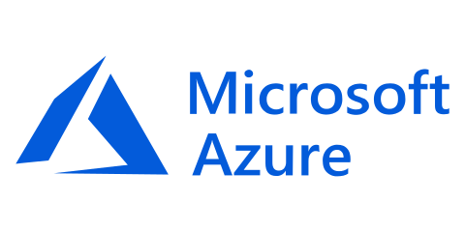
CLOUD COMPUTING SERVICE MODELS
PAAS(Platform As A Service): A service model where applications are delivered over the internet. Supports scalability, security and redundancy. Ex: AWS , Microsoft Azure etc..
SAAS(Software As A Service): A service model where applications are hosted by a service provider and handed over to customers using internet. Ex: DropBox, etc..
IAAS(Infrastructure As A Service): A service model that provides virtualized computing services over the internet for customers like VM. Ex: Google Compute Engine etc..

Slide 5
BEFORE CLOUD NATIVE…..
Before Cloud Native Applications came into the picture…We had CLOUD-READY applications which were being used extensively. Cloud Ready Applications are the applications which can be effectively deployed into private or public cloud.
Compared to cloud native applications, they can be easily deployed but cannot be scaled….user or the programmer need to manual adjust the app performance to make sure it doesn’t exceed the workload.
Cloud- ready applications are also infrastructure dependent and should abide by the respective infrastructure schema.

Slide 6
WHAT EXACTLY IS CLOUD NATIVE APPLICATION???
Cloud native applications are the applications which are developed with services packaged in CONTAINERS,deployed as MICROSERVICES and managed on elastic infrastructure through DEVOPS automation and CONTINUOUS DELIVERY workflows.
Cloud native applications offer great scalability and flexibility than normal cloud based applications and can be effectively deployed on any infrastructure.

Slide 7
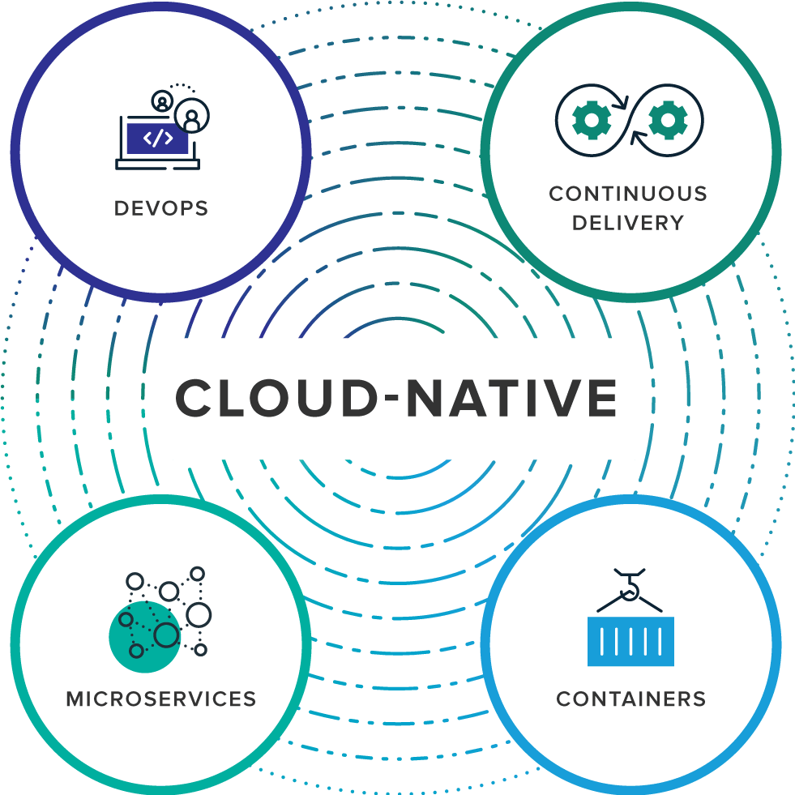
CLOUD NATIVE APPLICATION ARCHITECTURE

Slide 8
Components of cloud native application
CONTAINERS: A standard unit of software that packages up all code and it’s modules so that the applications run quickly and reliably from one environment to other.
Ex: Docker Containers etc…
Containers are more efficient, standard, lightweight and secure than Virtual Machines(VM)
Unlike VM, containers can be processed over the same Host OS.
A container main component is the Container Image which is a lightweight module that includes everything needed to initialize and run an application-libraries etc…

Slide 9
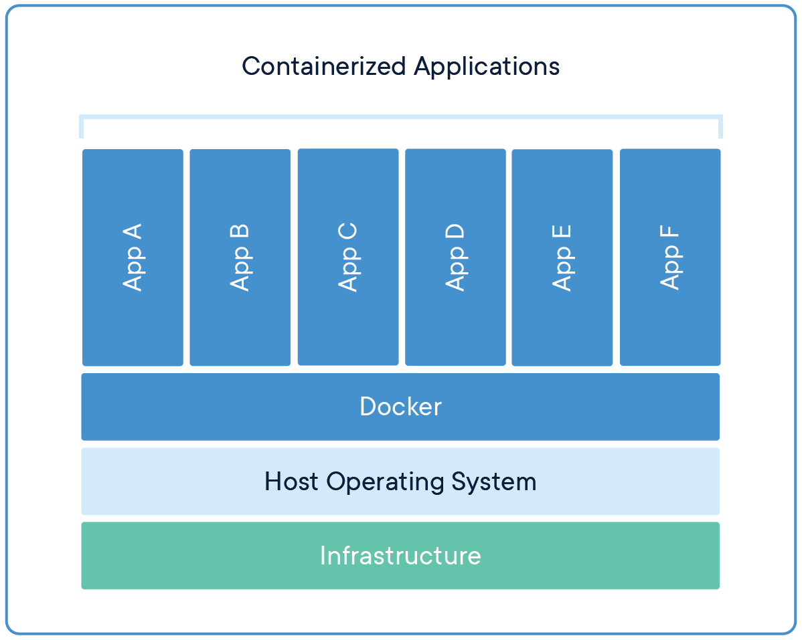
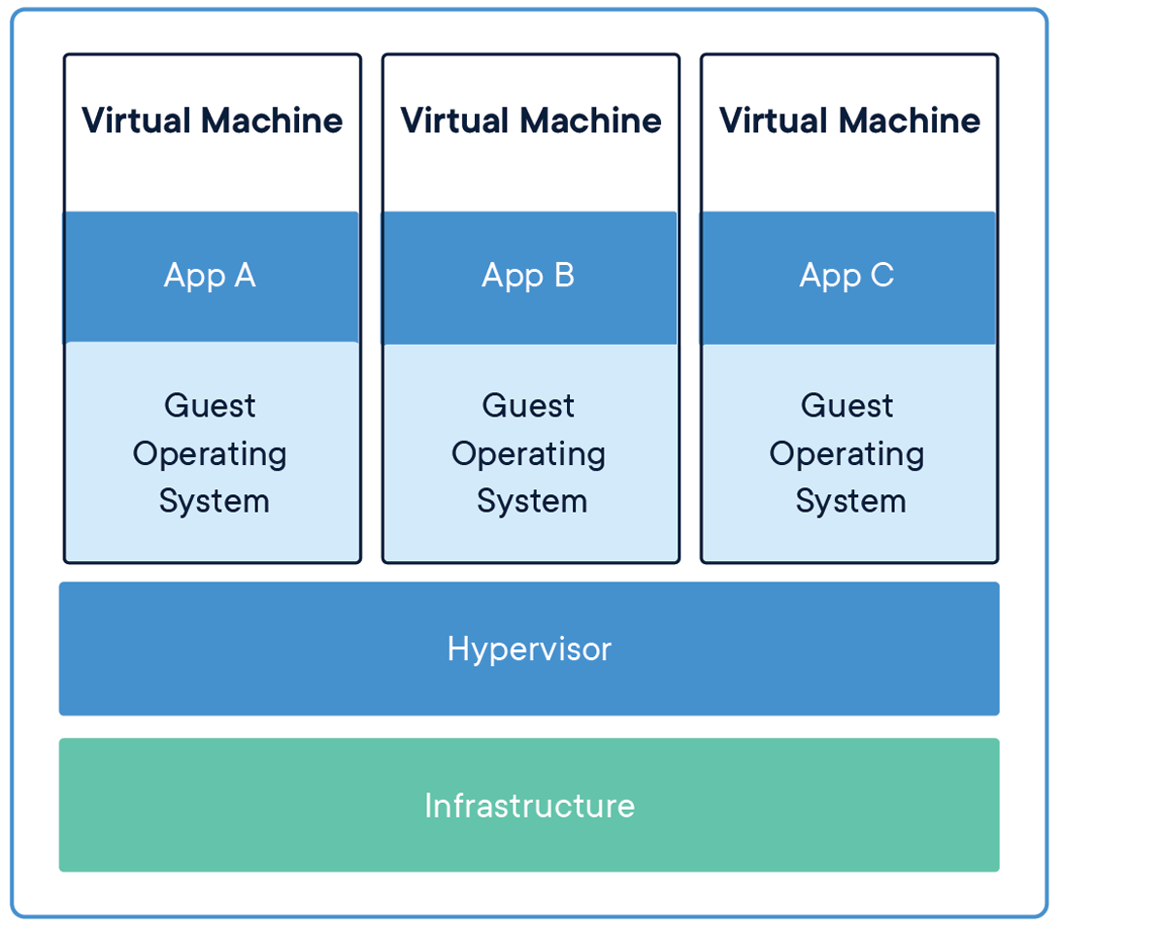
Difference between containers and virtual machines

Slide 10
MICROSERVICES: Microservices are software components that cluster and wrap up the container components and deploy them to outer servers. Generally Docker containers are deployed using clusters, nodes and pods.
KUBERNETES is a container orchestration tool that manages all containers and helps in devops,microservices thus making a complete package.
Nodes: Node is a worker machine in kubernetes which is a physical machine. Each Node is managed by the Master Cluster.
Pod: A pod is a sub-worker created to host our application instance. It also manages resources such as volumes, networking ports etc…

Slide 11
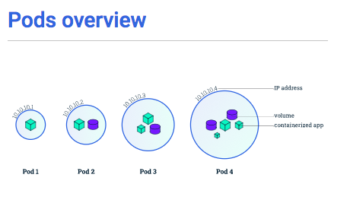
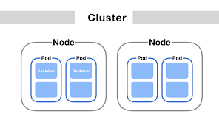

Slide 12
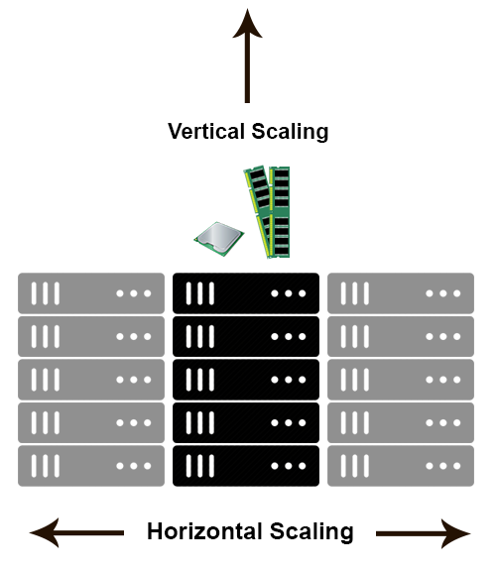
Devops Automation and Continuous Delivery:
A Software testing tool, devops is the automation method that involves scaling of applications….scaling is the process where the cpu workload of the workload is dynamically resized based on the workload and the resources allocation of a specific sub-task. Cloud-native applications supports scaling which makes them very efficient. They are two types of scaling- Horizontal and vertical scaling.

Slide 13
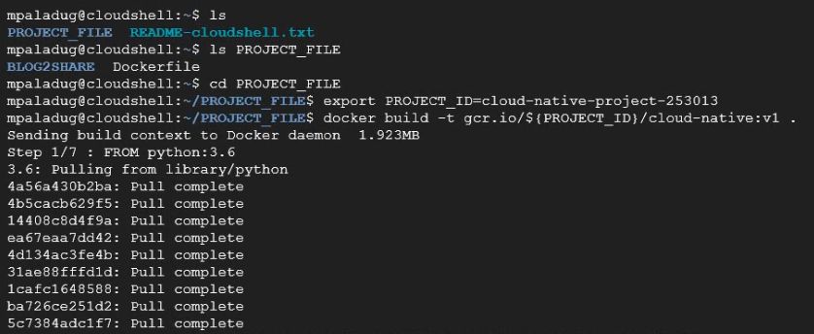
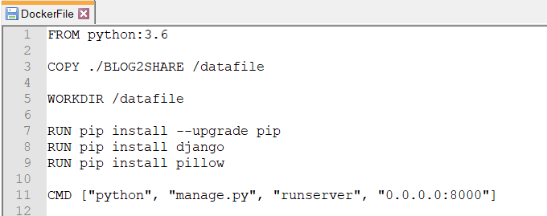
CONTAINERS
Containers are software components that packages up all code and modules as a complete package. Users can pull a image from the docker hub registry or create their own image schema using 2 or more images. For creating the own image, users generate a DockerFile and create a new image from them(DockerFile has no extension).

Slide 14
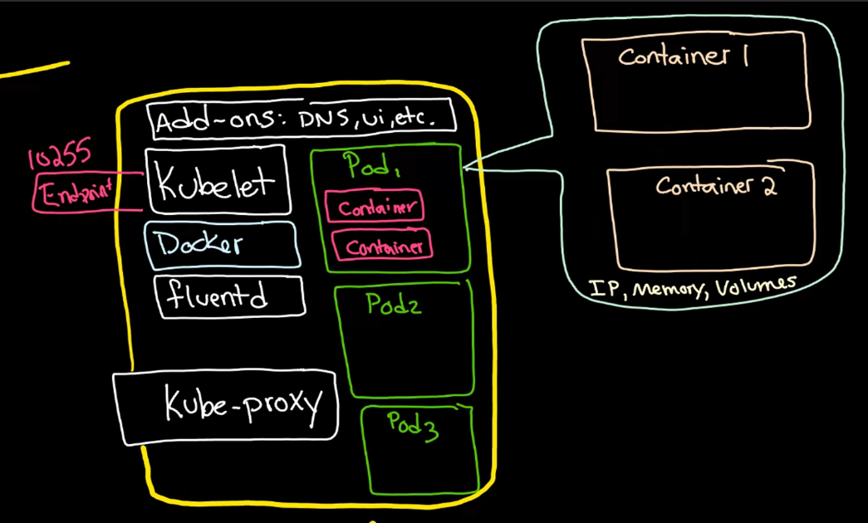
MICROSERVICES(NODES AND PODES)
Kubernetes deploys the docker container into a kubernetes cluster which is a collective package of modules. Node is the cluster worker where the pods run. Pod is a intermediate container in which the deployed container runs. A node is a cluster worker which consists of kubelet, pods and kube-proxy and other networking ports. If a pod crashes then it is conveyed to the cluster master through the kubelet. The kube-proxy plays a role in the interconnection of nodes if the container deployed is a web
application. The node also
contains DNS modules etc….

Slide 15
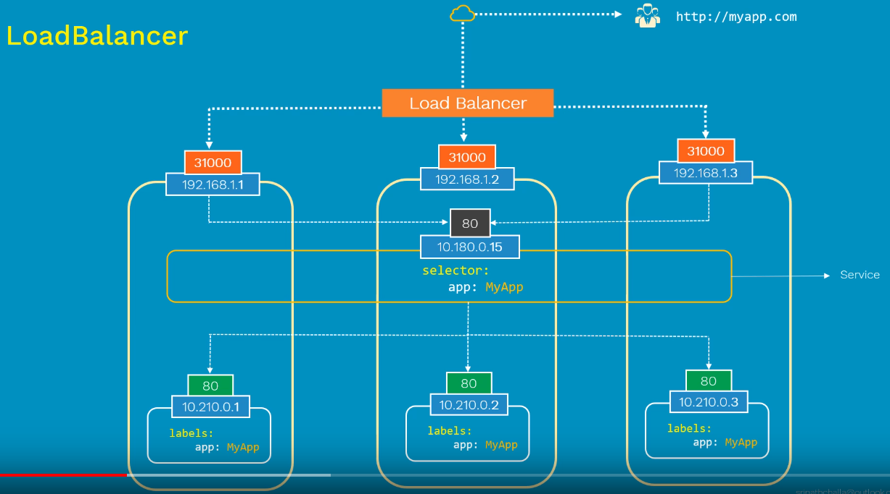
DEVOPS AND AUTOMATION
After the Microservices part is complete, the application is exposed to the world. The application is scaled and the kubernetes load-balancer is enabled. The Load-Balancer is a component which creates multiple replicas of a application. This enables scaling up the application so that
the workload is effectively managed. The internal logic of the load balancer will manage up the distribution of services.

Slide 16
The development of cloud native application
Software code and modules
Packaging the code into a container using DOCKERFILE
Creating the container image and checking the application on a local host server
Maintaining the final deployment and automating it’s performance via scaling
Creation of a KUBERNETES cluster with nodes and deploying the container image
Deploying the services with the help of pods and nodes
Exposing the application to the outer world

Slide 17
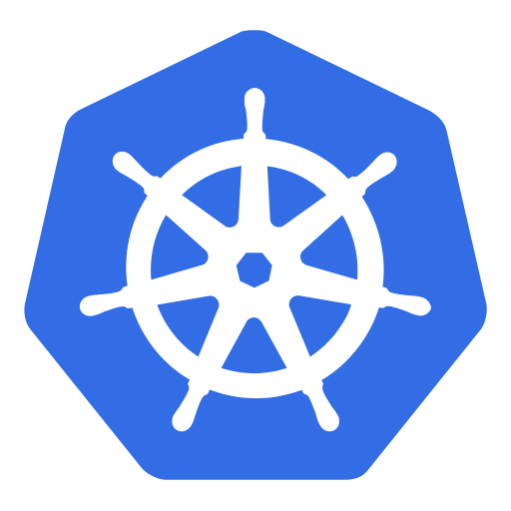
CLOUD NATIVE API’s
In the present technological resources available, docker and kubernetes are the API modules available to all programmers where applications can be wrapped in a container , deployed ,processed and scaled effectively. But the main disadvantage in this regard is the scaling of the applications is decided and done manually based on the size, schema of the application code.
Many organizations and forums from then started on developing a efficient, secure cloud-native API modules where a software code can be wrapped, deployed, scaled and studied from scratch to finish.

Slide 18
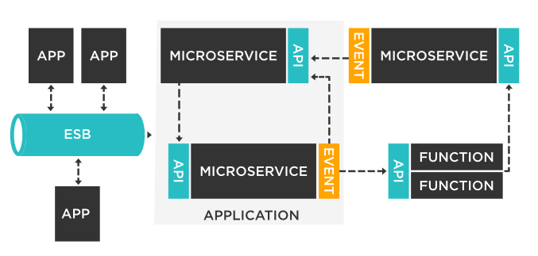
Recently, in February 2019, TIBCO software solutions, an organization were able to patch up a module in Microservices, a limited version of the API module was released where automated microservices were provided over an ESB(Enterprise Service Bus). The module was very much successful in its working and a complete beta API version is in development.

Slide 19
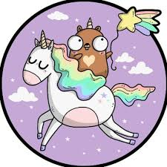
Another good API developed is kubicorn- a kubernetes infrastructure API that manages, scales up applications with cluster API. In precise words it is a kubernetes wrapper API. These (kubicorn + cluster API) is currently undergoing some patch developments and are not fully in action. By the current trend, kubicorn will be available by 2020 by latest.

Slide 20
The Applications of cloud native applications in this modern time
Cloud native applications help programmers to build powerful applications that can rule the world!! But for any application to succeed one factor plays a vital part. STABILITY. When multiple users are using an application it should be able to cater all the users with their requirements without any lack of service.
For example: Cloud native application can also be a simple web application- so the Programmer must make sure that the workload traffic is effectively handled otherwise it may lead to crashing of the web-application.
Many popular organizations like Google, Facebook, Twitter, ticker booking platforms etc effectively cater their workload without any problem using microservices etc… and the question arises HOW?????. Two special cases were taken and studied – Twitter and Google.

Slide 21


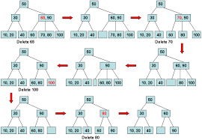
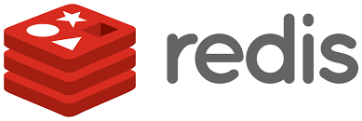
TWITTER manages about 250 million tweets/day and more this is a record!!!. Effectively scaling and traffic maintenance has made twitter more successful. Twitter scales all its incoming data using REDIS DATACENTER. Redis is a open-source distributed datacenter network organization. Redis almost provides 400TB for each datacenter and uses B-tree algorithm for management which helps it to effectively handle data as well as traffic.

Slide 22
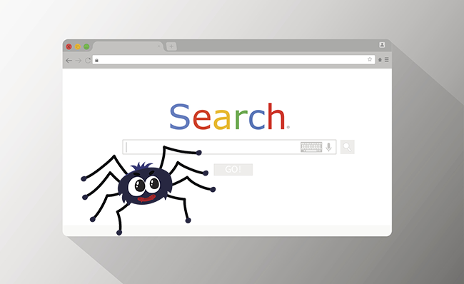
GOOGLE like twitter also uses datacenters for managing its data as well as improvising it’s traffic. Some concepts like BIGDATA is also implemented. Not only on the management side, on the other hand Google uses Spiders crawling methods, Page Rank Algorithm and also it’s own devised PIGEON algorithm for scaling and fast performance of the search engines. Spiders are special Googlebots developed by Google that use spider habitat mechanism for handling a user needs and requirements. The spider-bot crawls to the website asked by the user and remembers all its previously and most frequently requested data streams. For every user-this algorithm is used so every user need is catered.

Slide 23
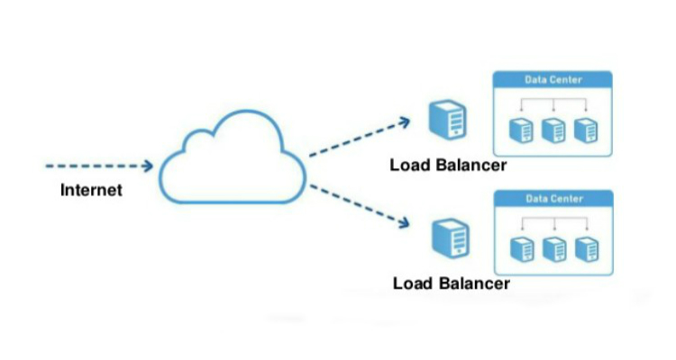
Google also uses terra-servers(A large Data Warehouse) developed by Microsoft, Google also implements Load-Balancer which balances all the traffic load using microservices with multiple large sized-cluster embedded in the datacenter console.

Slide 24
CONCLUSION
From normal cloud-ready applications, technological advancements made programmers create more powerful,stable,secure and robust cloud-native applications which can be deployed anywhere and used everywhere. Containers, microservices, devops automation and continuous integration delivery are the components vital in developing an ideal cloud-native application. With effective processing and deployment powerful applications can be developed easily and can be used for the greater good thus making the world a better place!!!!

Slide 25
THANK YOU

